Slide 1
THERAPEUTIC PILATES
PHYSI
THERAPY
SERVICES BROCHURE
MASSAGE RELAX
Héctor J. García Umpiérrez
Physiotherapist
Chartered No. 673
hectfe_x@hotmail.com
Phone No. : 636 57 22 80
Notes:
PAGINA 1 – PORTADA

Slide 2
MEDICAL REHABILITATION
& PHYSIOTHERAPY
THERAPIES
Functional Pilates
Therapeutic Pilates
Regeneration of soft tissue
Prevention & Treatment of Sport injuries
Electrotherapy
Massotherapy

Slide 3
MEDICAL REHABILITATION
& PHYSIOTHERAPY
MASSAGES
Therapeutic
Sports massage
Relax
Tension-relieving & decontracting massage
Manual (Hands-on) therapy
Cranial sacral massage

Slide 4
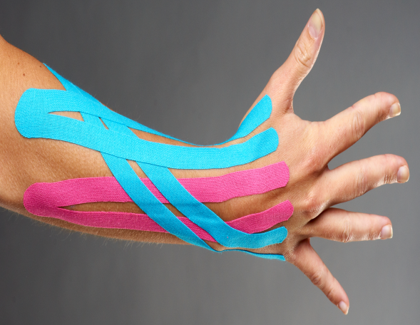
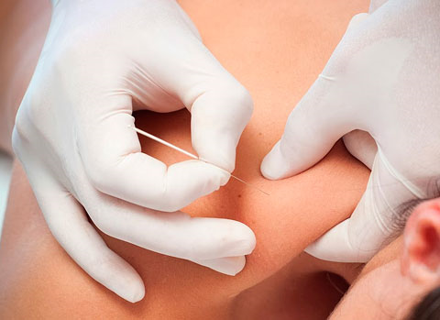
MEDICAL REHABILITATION
& PHYSIOTHERAPY
TREATMENTS
Kinesiology – Kinesiotape (Neuromuscular disorders)
Joint manipulation
Dry needling
Therapeutic nutrition (Orthomolecular) for musculoskeletal & rheumatic disorders
Soft tissue pain & mobilization
Sports injuries

Slide 5
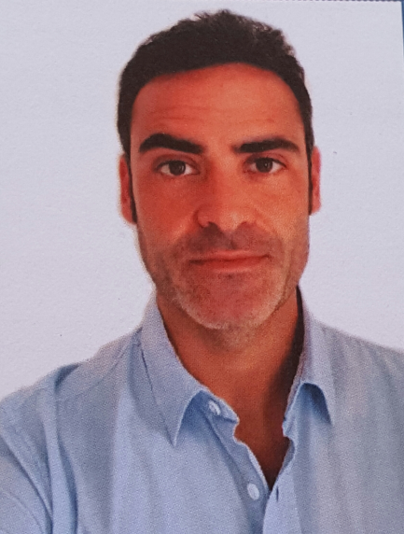
Héctor J. García Umpiérrez
Physiotherapist
English Spoken
Avalilable 24/365 upon previous arrangement at:
hectfe_x@hotmail.com
or
Phone No. : 636 57 22 80

